Slide 1
SPECIAL USE PERMIT CASE NUMBER WSUP20-0027
(Copart Sublot)
Washoe County Board of Adjustment
February 4, 2021

Slide 2
Request
Inoperable Vehicle Storage Use Type and to approve Major Grading in the amount of approximately 6,465 cubic yards and a disturbance of approximately 9.3 acres (approximately 405,336 square feet) and to eliminate all required landscaping in accordance with Article 412, Landscaping, and to eliminate all required pavement in accordance with Article 410, Parking and Loading on two parcels of land.

Slide 3
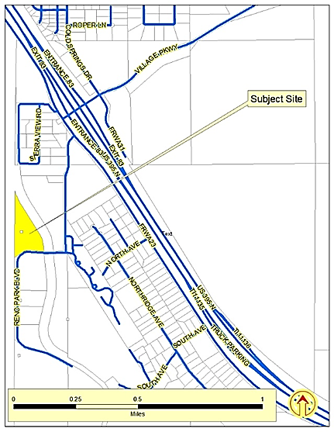
Vicinity Map

Slide 4
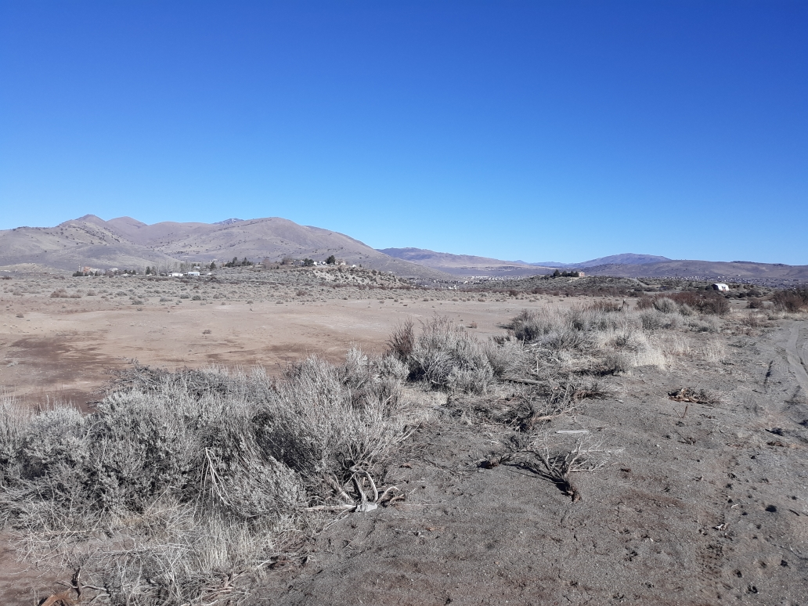
Site Photo

Slide 5
Project Evaluation
The subject site is essentially flat
Evidence of previous disturbance
Appropriate for the Inoperable Vehicle Storage use
Grading is intended to prepare site and enhance screening
Paving of driveways is required in accordance with the Development Code
Paved parking is required in accordance with the Development Code
Site proposed to be surrounded by 8’ solid fence
Landscaping adjacent to Reno Park Boulevard

Slide 6
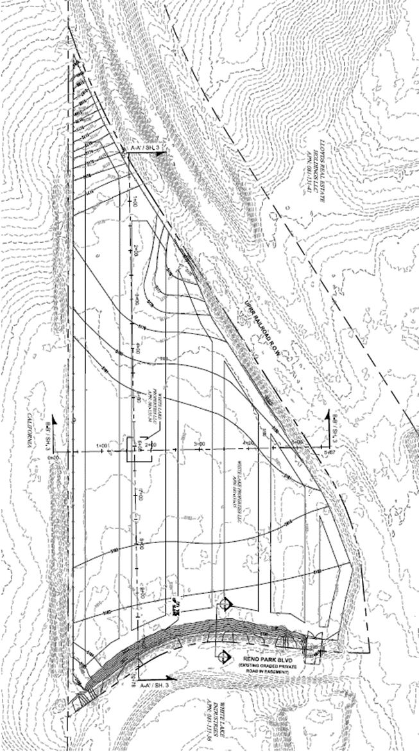
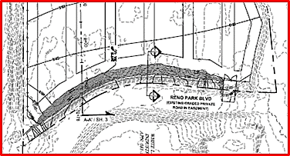
Grading Plans

Slide 7
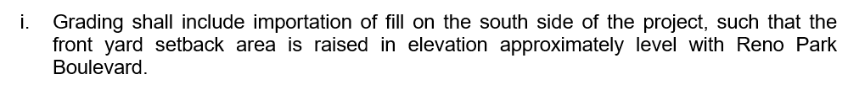
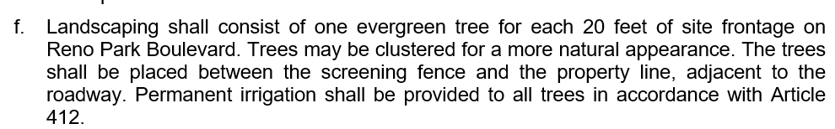
Conditions Related to Grading

Slide 8
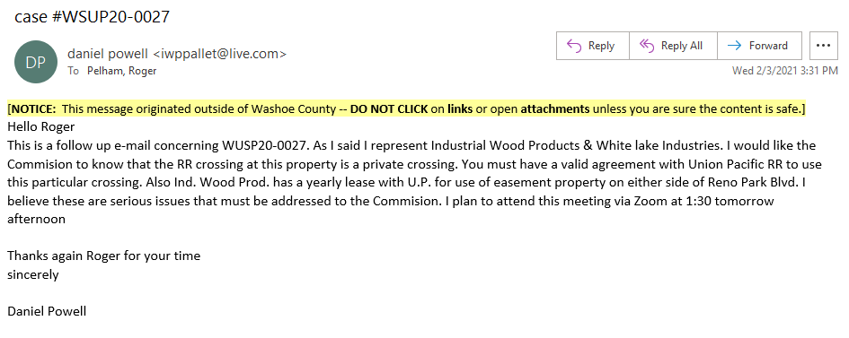
Public Comment

Slide 9
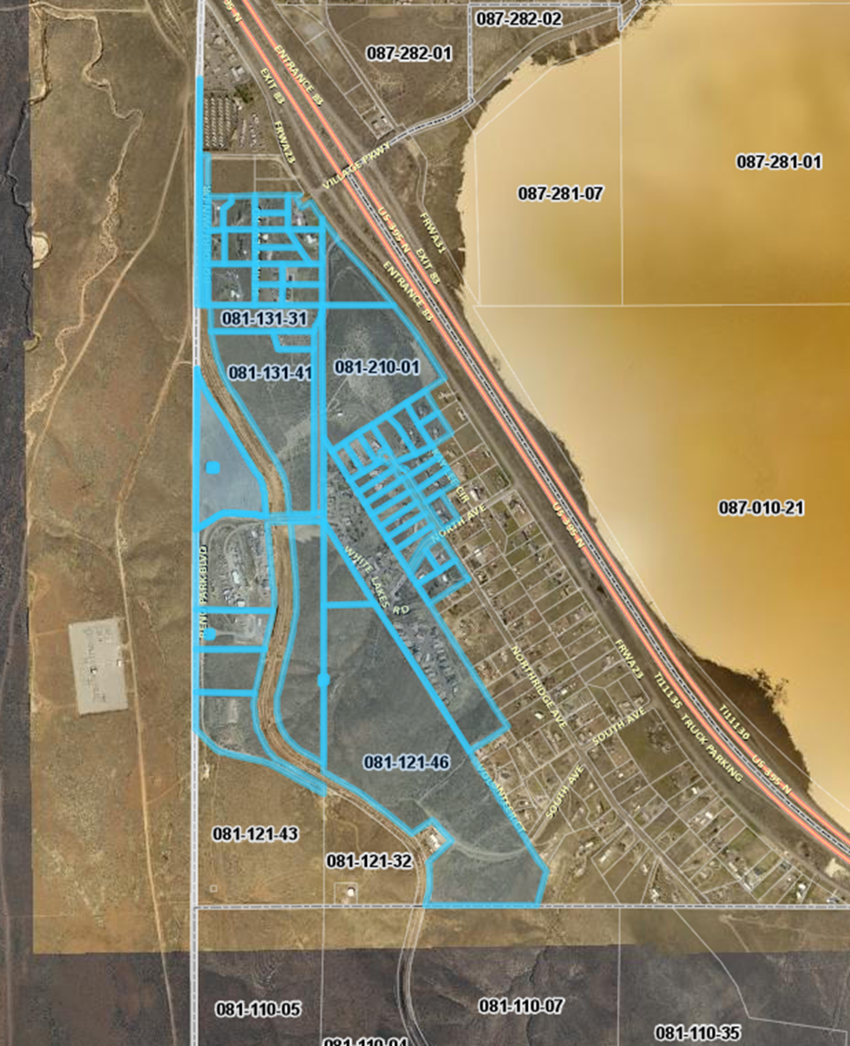
Public Notice & CAB
Notice sent to 55 affected property owners
The CAB voted to recommend approval and expressed some concern regarding the amount of traffic, particularly heavy equipment accessing the site and the noise that may be created.

Slide 10
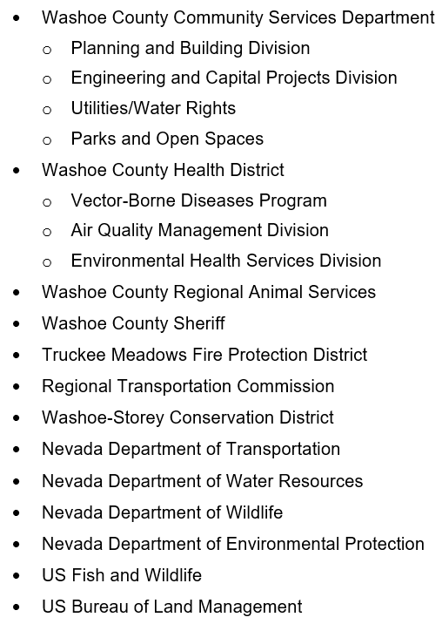
Reviewing Agencies

Slide 11
Additional Condition Recommended
1 o.
Prior to approval of any building or grading permit for the proposed use, the applicant shall provide documentation, acceptable to Washoe County, that the applicant has a right to traverse the Union Pacific Railroad to access the subject site, for an industrial use.

Slide 12
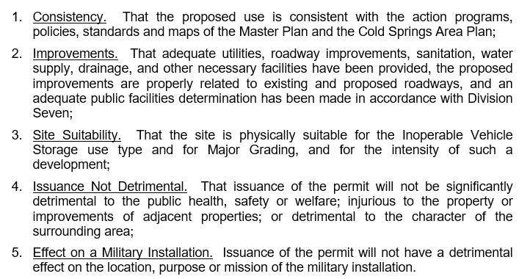
Special Use Permit Findings
Staff Comments on Page 8 of Staff Report

Slide 13
Recommendation
After a thorough analysis and review, Special Use Permit Case Number WSUP20-0027 is being recommended for approval with conditions.

Slide 14
Possible Motion
I move that, after giving reasoned consideration to the information contained in the staff report and information received during the public hearing, the Washoe County Board of Adjustment approve with conditions (included at Exhibit A to the staff report, and with the additional condition 1o, as presented by staff) Special Use Permit Case Number WSUP20-0027 for Copart of Arizona, Inc, having made all five findings in accordance with Washoe County Code Section 110.810.30.

